Slide 1
Process Mapping:
Mortgage Orientation

Slide 2
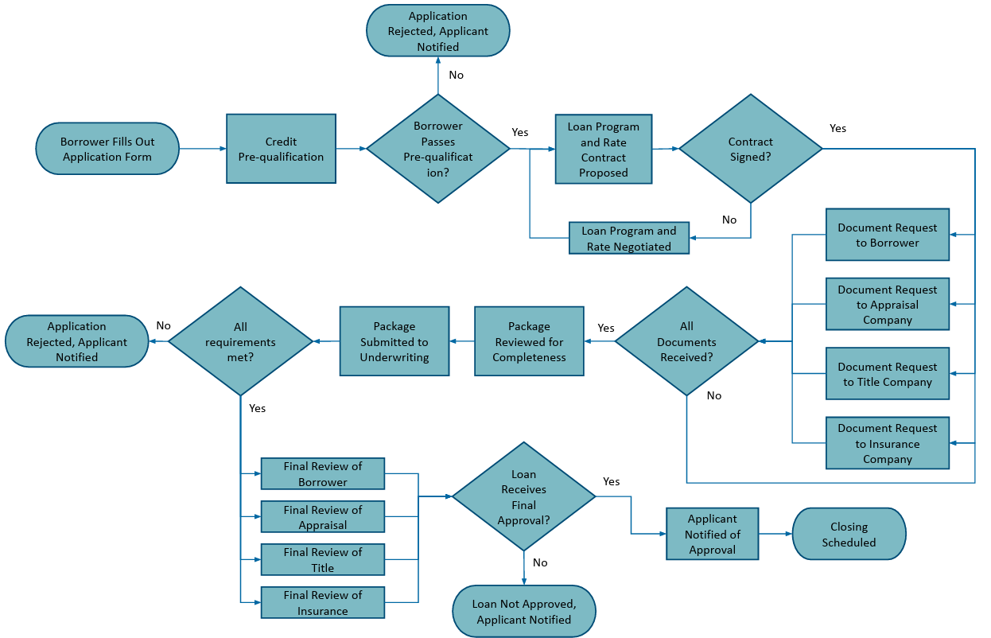
Process Mapping – Commonly Used UML Symbols

Slide 3
Opportunities for Process Improvement: Mortgage Orientation
Process Improvement Opportunities
Utilize non-traditional data sources, such as payroll businesses, social media presences, property management companies, etc., to manage underwriting risk in a different way.
Utilize AI in review process to automate and simplify processes.
Automate pre-qualification steps.
Identify risks and use AI/risk analysis to try and find ways to mitigate it so the loan has a higher chance of being approved.

